Slide 1
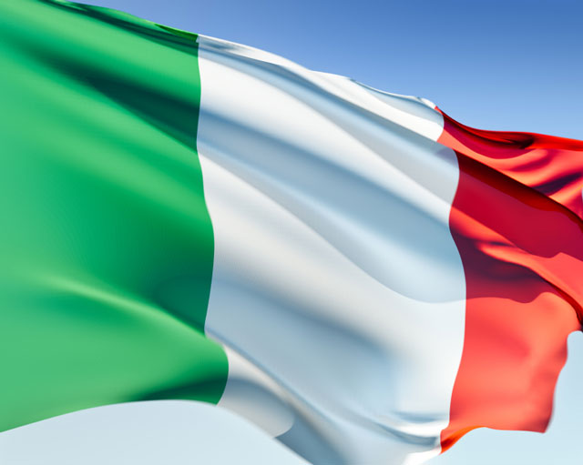
Notes:
http://www.italian-flag.org/italian-flag-640.jpg

Slide 2
Italy

Slide 3
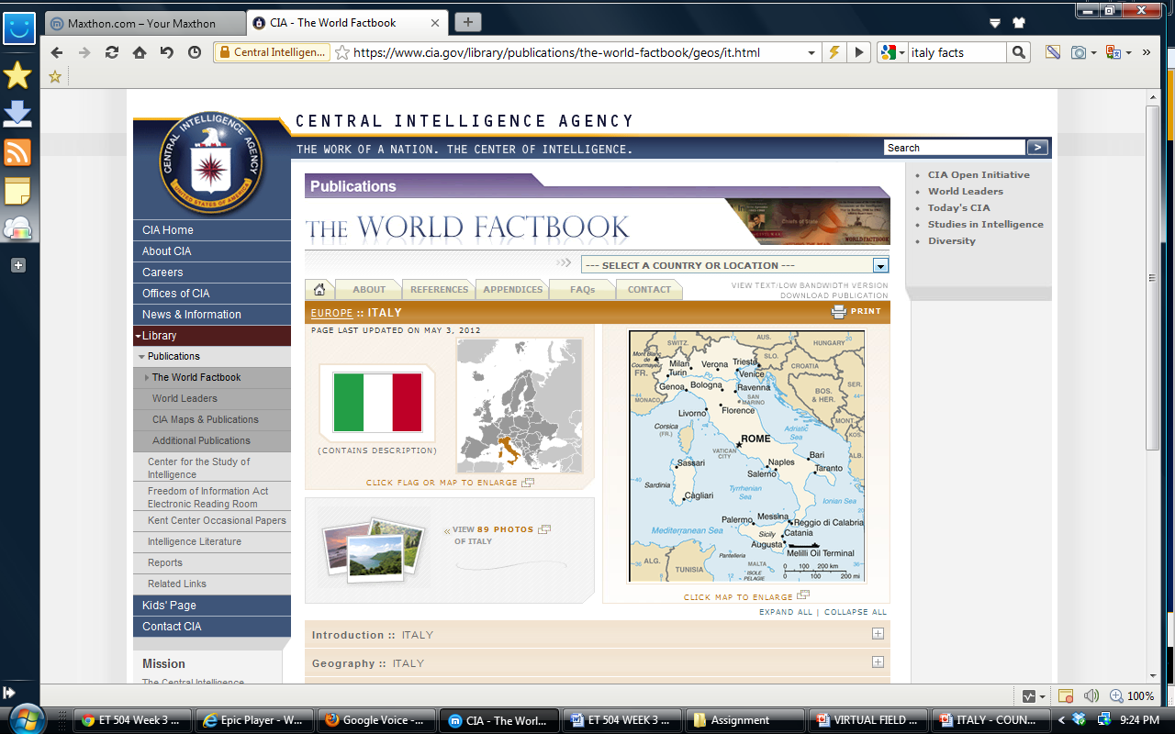
https://www.cia.gov/library/publications/the-world-factbook/geos/it.html

Slide 4
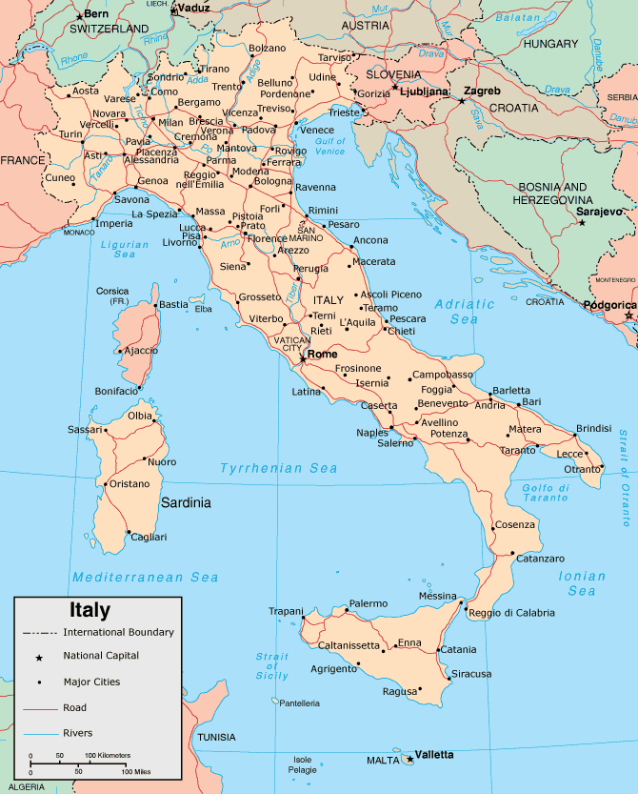
Notes:
http://www.map-of-italy.org/map-of-italy.gif

Slide 5
Learning from Map
Italy is a peninsula, surrounded by water on 3 sides.
Italy is located on the European continent.
Italy is bordered by many countries including: France, Switzerland, Austria, Slovenia, and Croatia.
Sicily and Sardinia are islands that are also a part of the Italian nation.

Slide 6
Resources for Italy Facts
http://www.state.gov/r/pa/ei/bgn/4033.htm
http://mymelange.net/mymelange/2010/06/50-italy-fun-facts.html
http://goitaly.about.com/od/planningandinformation/p/italyprofile.htm
http://www.kids-world-travel-guide.com/italy-facts.html
http://www.infoplease.com/ipa/A0107658.html

Slide 7
What 5 facts did you find most interesting? Build cards to present those facts.

Slide 8
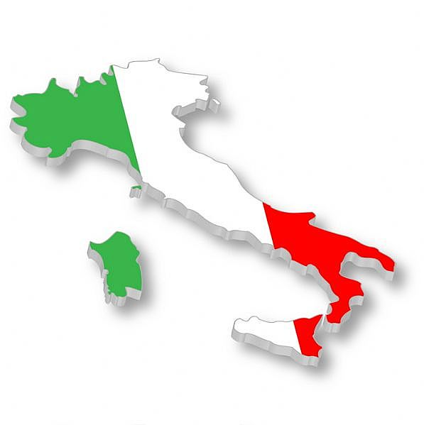
Population
61 Million
Notes:
http://exploredia.com/italy-population-2011/ - Fact
http://4.bp.blogspot.com/_lUac_pDCMpI/SyVGbfyTGJI/AAAAAAAADCc/KNAlaHv7mqw/s1600/Italy%2BFlag%2BMap - Image

Slide 9
Cities
Rome (Roma)
http://facts.randomhistory.com/2009/03/07_rome.html
Milan (Milano)
http://goitaly.about.com/od/moreitaliancities/p/milan.htm
Naples (Napoli)
http://goitaly.about.com/od/naples/a/naples.htm
Florence (Firenze)
http://www.pcc.edu/about/international/study-abroad/florence/documents/FlorenceFunFacts.pdf
Venice (Venezia)
http://www.comune.venezia.it/flex/cm/pages/ServeBLOB.php/L/EN/IDPagina/40953
http://www.veneto-explorer.com/facts-about-venice.html

Slide 10
Choose a city and build 5 cards to tell about the city, about its history, about its landmarks etc…

Slide 11
Virtual Field Trips
Rome - http://www.italyguides.it/us/roma/rome_italy_travel.htm
Milan - http://www.virtourist.com/europe/milan/index.html
Naples - http://www.italyguides.it/us/napoli/naples.htm
Florence - http://www.italyguides.it/us/florence/florence_italy.htm
Venice - http://www.italyguides.it/us/venice_italy/venice_travel.htm

Slide 12
Famous Italians
Christopher Columbus
Leonardo Da Vinci
Michelangelo
Benito Mussolini
Guiseppe Verdi
Galileo
Giacamo Pucini
Marco Polo
Florence Nightingale
Enrico Caruso
Sophia Loren
Rudolph Valentino
Giuseppe Verdi
Amerigo Vespucci
Antonio Vivaldi
Gioacchino Rossini
Notes:
www.biography.com

Slide 13
Choose 3 famous people from your country, build a brief biography of each person, and locate an image.

Slide 14
Famous Italian Landmarks
Leaning Tower of Pisa
Vatican City
The Colloseum
Trevi Fountain
Capitoline museums
Sistine Chapel
St. Mark's Square in Venice
Pompeii
Mt. Vesuvius
The Spanish Steps
Milan Cathedral (Duomo di Milano)

Slide 15
Choose 3 landmarks in Italy and build a slide for each with images and text.

Slide 16
Italian Sculpture and Art
Sistene Chapel
Mona Lisa – Leonardo da Vinci
Michelangelo's David
The Last Supper – Leonardo da Vinci
Michelangelo's Pieta

Slide 17
What is your favorite piece of Italian artwork? Why is it your favorite? Tell us about it? Provide and image.

Slide 18
Italian Operas
Aida, by GiuseppeVerdi
Cavalleria Rusticana, by Pietro Mascagni
Il Barbiere de Siviglia, by Gioachino Rossini
La Gioconda, by Amilcare Ponchielli
La traviata, by Giuseppe Verdi
L’elisir d’amore, by Gaetano Donizetti
Madama Butterfly, by Giacomo Puccini
Nabucco, by Giuseppe Verdi
Norma, by Vincenzo Bellini
Pagliacci, by Ruggero Leoncavallo

Slide 19
Choose and opera and give a brief summary of what the opera is about. Describe the opera’s plot. Who are the main characters?

Slide 20
Famous Italian Inventors and Inventions
Count Alessandro Giuseppe Antonio Anastasio Volta – the Battery
The Catapult
Parachute – Leonardo da Vinci
Eyeglasses
Galileo – the thermometor
Bartolomeo Cristofori – the piano
Nicola Tesla – the radio
yoyo
Notes:
http://www.enchantedlearning.com/inventors/italy.shtml

Slide 21
This would be my example of the potential and possibilities of the “Country and Culture” project. Students will be given a list of required information and also options and choices that they must make to complete the project.

